Slide 1
Italian Energy Strategy
Group 1
Thomas Smith, Wei Chin, Imran Ishak,
Oladipo Phillips, Michael Hickey
ELEC6115 National Energy Strategies Assignment

Slide 2
Presentation Agenda
Introduction and Background
Proposed Energy Strategy
Justification
Economic Factors
Environmental Factors
Socio-political Factors
Conclusion

Slide 3
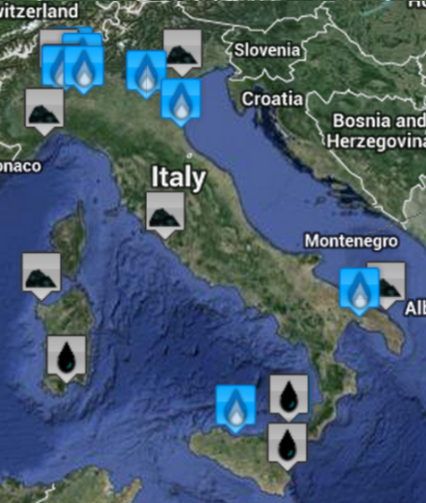
Introduction
Energy mix dominated by fossil fuels
Past power deficits
Highest energy prices in Europe
20 largest power plants in terms of output
Source: EU Emissions Trading System
Notes:
Fossil fuels make up 76.8% of all electricity generation and 83% of all primary energy use.
Largest 20 power stations run on gas, coal or oil.
Largest facility is Montalto Di Castro Power Plant operated by Enel. 3.6 GW output is generated from 4x660MW Fuel oil and 8x120MW CCGTs.
Power deficits in 2003/04 caused an estimated capacity surplus of 12.3GW due to rapid investement in CCGTs and renewables (particularly Solar).
Looking at the map – The North is more densely populated than the south.

Slide 4
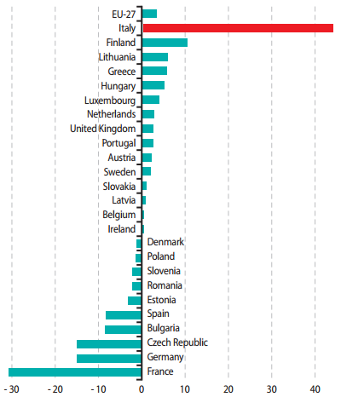
Current Energy Situation
Foreign imports account for 83% of primary energy needs
Due to limited resources
Dependence on fossil fuels
Largest net importer of electricity
47.5 billion kWh imported
15% net imports (e.g. French Nuclear)
1.8 billion kWh exported
Net Electricity Imports 2010 (TWh)
Source: EU eurostat Energy, Transport & Environment Indicators 2012 Edition
Notes:
Primary Energy – Total energy use for all sectors, not just electricity generation.
Typical for the past decade.
Fossil fuels largely imported from Algeria, Russia and Libya.

Slide 5
Primary Energy Mix - 2010
Gross primary energy demand = 2183.9TWh
63%
Hydroelectric
Source: An Overview of Italy’s Energy Mix
Notes:
83% primary energy supply is imported

Slide 6
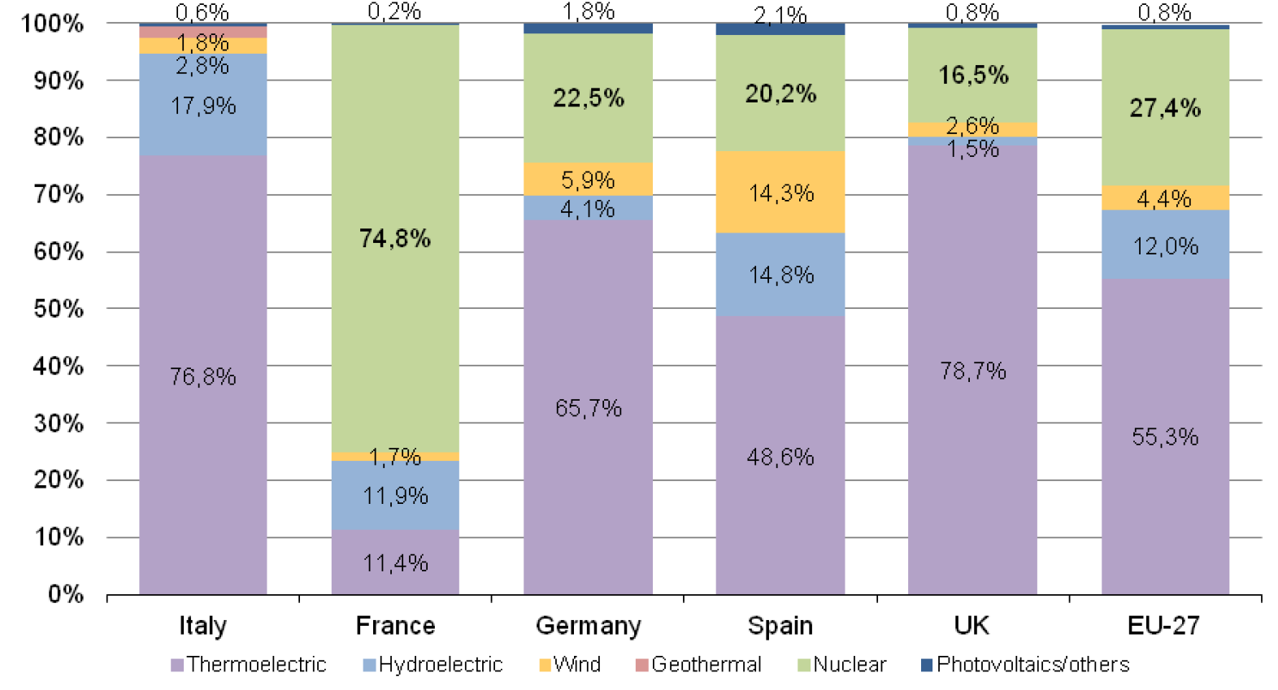
EU GROSS Electricity Mix Comparison
(Import NOT included)
Source: fri.org. 2013. IFRI - E-note - Notes de l'Ifri - An Overview of Italy's Energy Mix - Institut francais des relations internationales. [online] Available at: http://www.ifri.org/?page=contribution-detail&id=7216 [Accessed: 23 Oct 2013].
Notes:
This figures displays a comparison between the electric energy production in various European countries. These data, represent gross production, before subtracting losses and pumped-storage, but do not include imports.

Slide 7
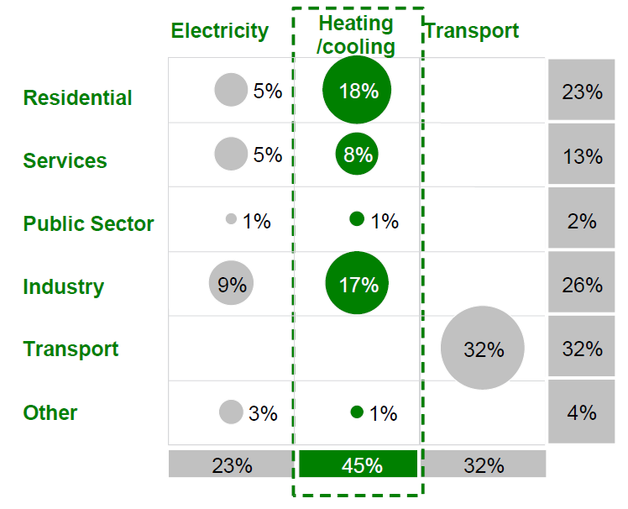
Final Energy Consumption
Source: NEB Data
Notes:
Largest sector is heating/cooling.
Important to consider when choosing energy mix.

Slide 8
Main Issues
Higher Electrical Prices
(than EU average)
Increasing Demand
Renewable Incentives
Import Dependency
Fossil Fuel Reliance
Notes:
Main Issues from a political perspective.
Average Italian price compared to EU & UK average – What is the difference. Charles.
Fossil fuels make up 76.8% of all electricity generation and 83% of all primary energy use.
Incentive – types (feed in tariff/tax break etc) – figure. Imran

Slide 9
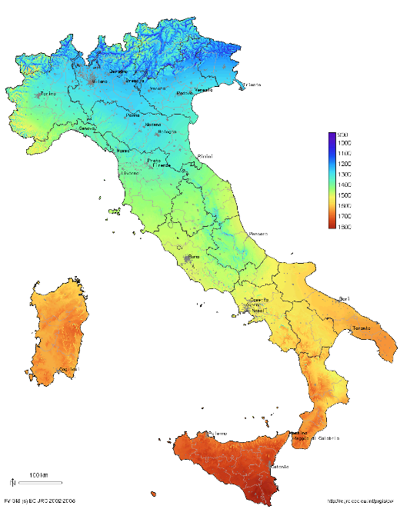
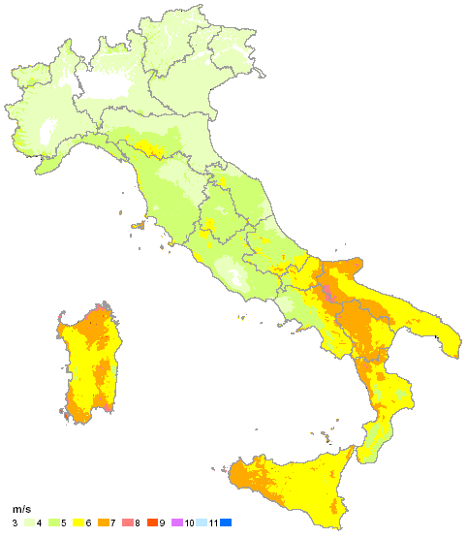
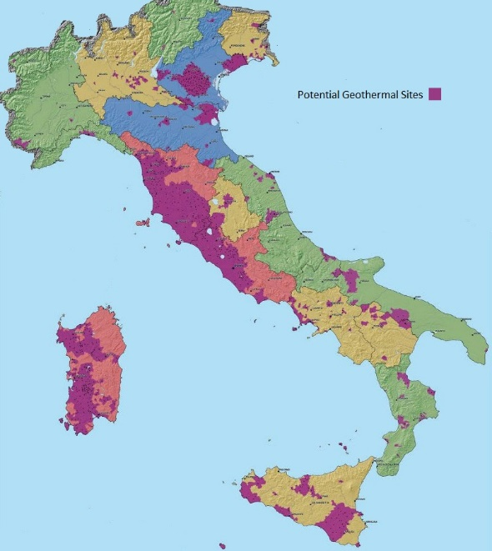
Renewable Potential
wind
Geothermal
Solar
Notes:
[1] http://www.geni.org/globalenergy/library/renewable-energy-resources/world/europe/solar-europe/solar-italy.shtml
[2] http://www.geni.org/globalenergy/library/renewable-energy-resources/world/europe/wind-europe/wind-italy.shtml
[3] http://www.lens.unifi.it/images/news/mappa_geotermica_italiana.jpg

Slide 10
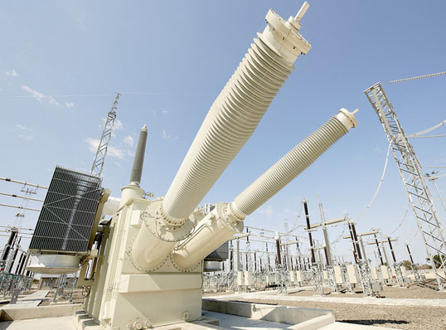
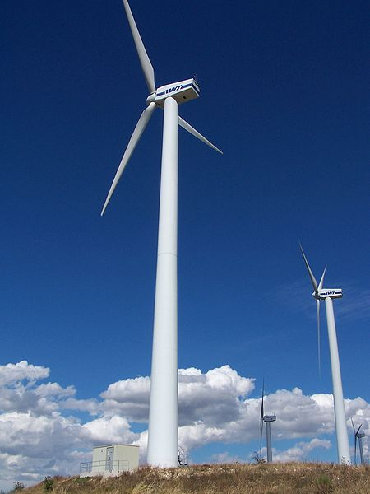
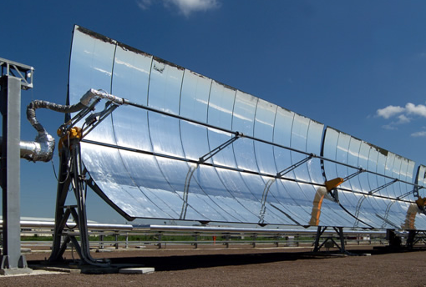
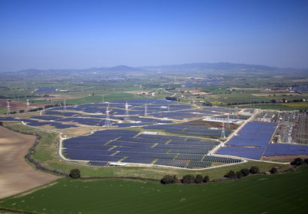
Proposed Strategy
DesertTec HVDC Link
The pathway to 2030
Wind Power
Increased Solar
Source: ABB Website, SunPower Website, Wikimedia
Notes:
DesertTec HVDC link – connecting solar power from Sahara with North Africa and Europe.
Use HVDC to cover the extremely large distances.
Example – 2000km 800kV HVDC link loses 5% compared to 10% to AC due to heating. (ABB website)
Increased Solar Power
Wind power.

Slide 11
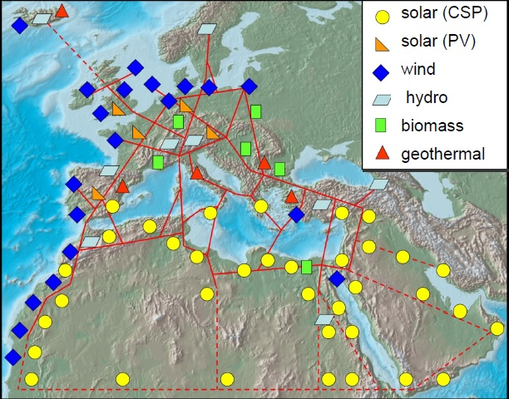
DesertTec HVDC Link
HVDC connection to Tunisia (Desertec) [1]
Current subsea Cables (Italy-Malta, Italy-Greece) [2]
Thermal Solar cheaper/renewable compared to fossil fuels [3]
Energy transfer revenues (internal congestion?)
Thermal solar plants combined with Geothermal [4]
Notes:
[1] http://www.desertec.org/
[2] http://www.industrie.gov.tn/fr/projetelmed/images/pdf/9_1_characteristics_interconnection.pdf
[3] http://www.tue.nl/fileadmin/content/onderzoek/Eindhoven_Energy_Institute_EEI/EnergyDays/Serie_1_2008_2010/2009_04_07/Mueller-Steinhagen-1c.pdf
[4] http://nsercpvin.wordpress.com/2013/04/18/cansia-2012-integrating-solar-thermal-with-geothermal/
[3]

Slide 12
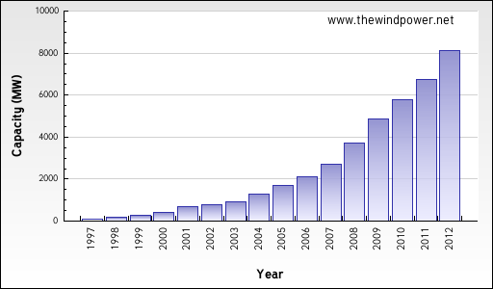
Wind Power
Current State
Total installed capacity: 8144 MW
Total electrical output: 13.1 TWh
4% of national electrical demand
By 2020:
National Action Plan
Wind generation 12680 MW (12000 MW on land, 680 MW offshore)
20 TWh/yr (18 TWh/yr on land, 2 TWh/yr offshore) by 2020
Directive 2009/28/EC – 17% of total energy consumption from RES by 2020
Cumulative Wind Installation (MW) of Italy

Slide 13
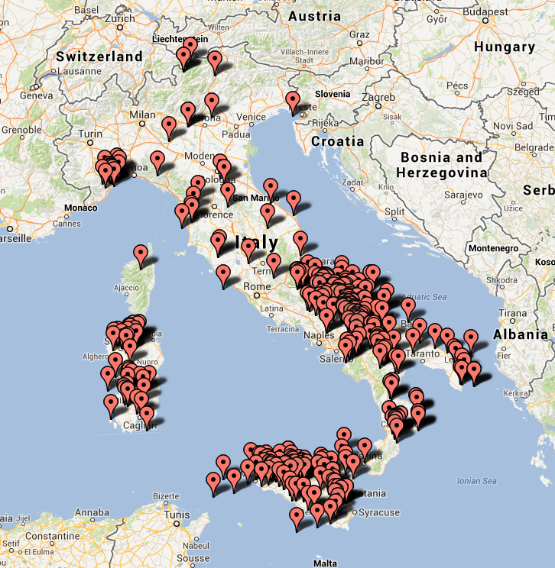
Moving Forward
Current Issues
Corruption in the sector ^{[1]}
Incentive Program ^{[2]}
Inadequate Grid Infrastructure ^{[3]}
Opportunities
Higher employment ^{[4]}
Legislation and Policy ^{[5]}
Research, Development & Demonstration of new technologies ^{[6]}
Pic: Location of Wind Farms in Italy
Notes:
1. http://www.renewableenergyworld.com/rea/news/article/2013/06/corruption-hit-as-italy-cleans-up-wind-sector?page=2 2. http://www.nortonrosefulbright.com/knowledge/publications/66177/european-renewable-energy-incentive-guide-Italy 3. IRENA-GWEC: 30 YEARS OF POLICIES FOR WIND ENERGY - ITALY 4. http://www.evwind.es/2010/05/05/wind-power-in-Italy 5. IEA Wind 2012 Annual Report - Italy 6. IEA Wind 2012 Annual Report - Italy

Slide 14
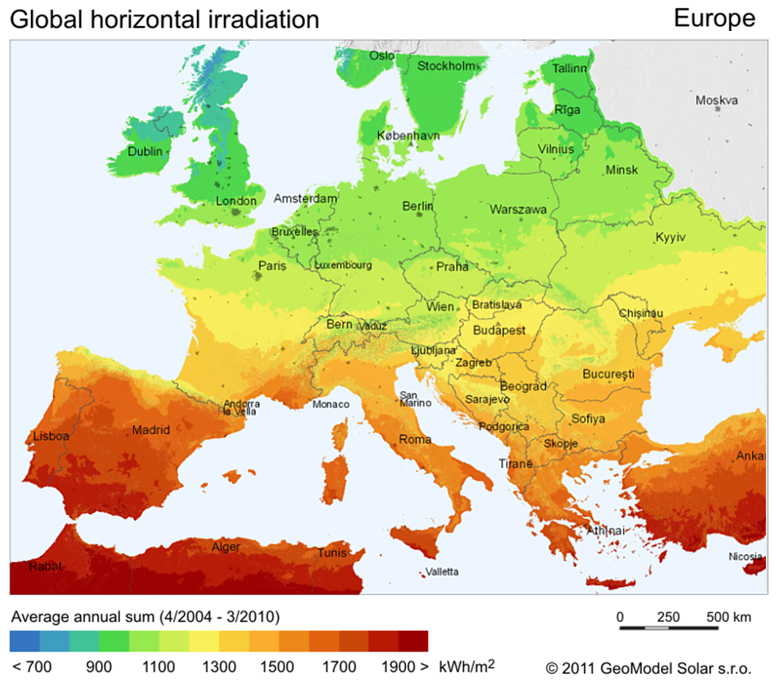
Increased Solar - Potential
One of the sunnier places in the EU
Horizontal Solar Irradiation
Source: Solar GIS
Notes:
One of the sunnier places in the EU – behind Cyprus, Portugal, Spain and Turkey but over 400kWh/m² greater yearly irradiation incident on optimally-inclined PV modules than Germany, who has the most installed solar capacity in the EU.
Installed 2.3GW in 2010 and a further 9.2GW in 2011
Cumulative PV capacity went from 3.5GW in 2010 to 12.8GW in 2011, 2nd behind Germany with 24.8GW, 3rd is Spain with 4.2GW.
Capacity surged due to strong incentives from Conto Energia.

Slide 15
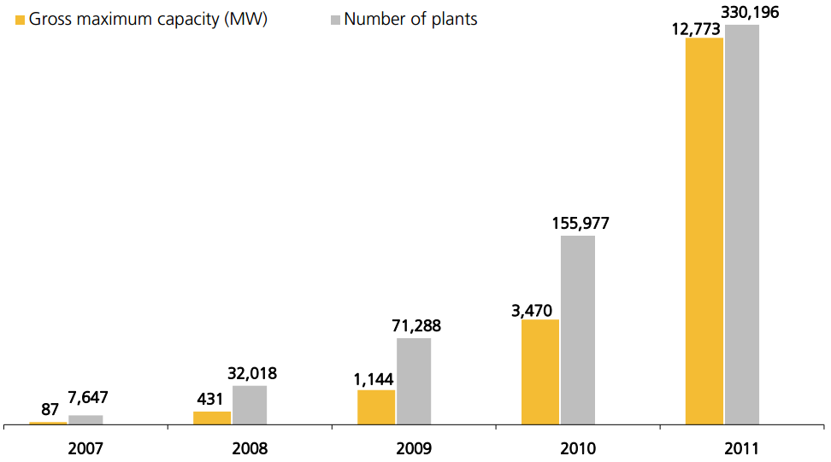
Increased Solar - Potential
One of the sunnier places in the EU
More than doubled capacity between 2010 and 2011
Number and Capacity of PV plants
Source: Gestore Servizi Energetici – Statistical Report 2011
Notes:
One of the sunnier places in the EU – behind Cyprus, Portugal, Spain and Turkey but over 400kWh/m² greater yearly irradiation incident on optimally-inclined PV modules than Germany, who has the most installed solar capacity in the EU.
Installed 2.3GW in 2010 and a further 9.2GW in 2011
Cumulative PV capacity went from 3.5GW in 2010 to 12.8GW in 2011, 2nd behind Germany with 24.8GW, 3rd is Spain with 4.2GW.
Predicted by some forecasters to overtake Germany in the next few years.
Capacity surged due to strong incentives from Conto Energia.

Slide 16
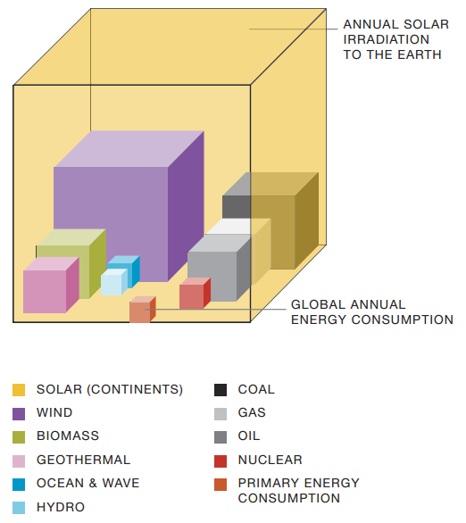
Increased Solar - Potential
One of the sunnier places in the EU
More than doubled capacity between 2010 and 2011
Estimated 42GW potential capacity in 2020 [1]
Potential of Global Solar Energy
Source: [1] European Photovoltaic Industry Association global Market Outlook for Photovoltaics 2013-2017 and Solar Generation 6: Solar PV Electricity Powering the World.
Notes:
One of the sunnier places in the EU – behind Cyprus, Portugal, Spain and Turkey but over 400kWh/m² greater yearly irradiation incident on optimally-inclined PV modules than Germany, who has the most installed solar capacity in the EU.
Installed 2.3GW in 2010 and a further 9.2GW in 2011
Cumulative PV capacity went from 3.5GW in 2010 to 12.8GW in 2011, 2nd behind Germany with 24.8GW, 3rd is Spain with 4.2GW.
Predicted by some forecasters to overtake Germany in the next few years.
Capacity surged due to strong incentives from Conto Energia.
Massive potential – enough energy hits the Earth in 90 minutes to meet global demand for 1 year.
42GW capacity estimate from European Photovoltaic Industry Association global Market Outlook for Photovoltaics 2013-2017 based on an accellerated scenario with PV meeting 8% of demand, that is the maximum growth possible with current market trends.

Slide 17
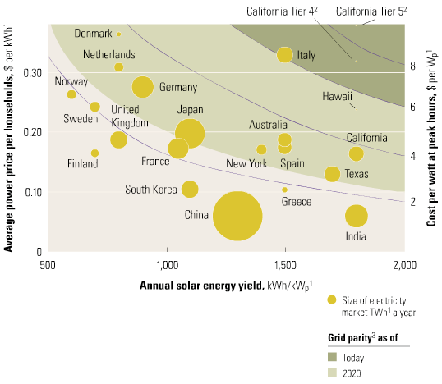
Increased Solar - Impacts
Economic – grid parity achieved
Global Grid Parity
Source: European Tribune
Notes:
Grid parity occurs when generation costs are roughly equal to electricity prices. It is expected that grid parity will be achieved in most of europe by 2030 (IEA).
A report by Deutsche Bank says that for small commercial enterprises that can achieve >50% self consumption, solar power is competitive with grid electricity in most parts of Italy.
ANEST organisation to develop concentrating solar power. Molten Salt CSP schemes allow 24 hour generation due to heat storage. The Archimede plant in the South is the first power station to solely use molten salt for heat transfer and storage. IEA says CSP has the highest growth potential (28% global demand by 2060 according to IEA). Develop Italian tool chain and technology potentially for export. 50MW plant requires 1500 people to construct for 2-3 years. Source ANEST.

Slide 18
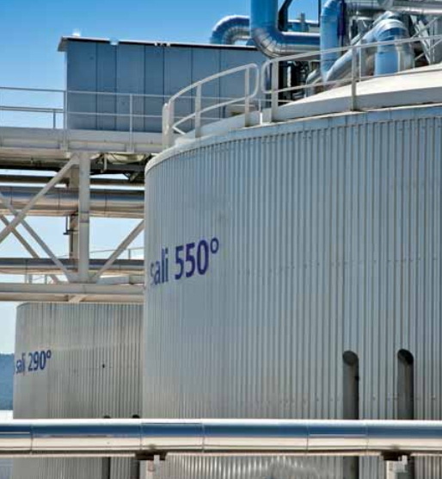
Increased Solar - Impacts
Economic – grid parity achieved
Italian expertise in molten salt thermal plants
Archimede Concentrating Solar Power Plant
Source: Archimede Solar Energy
Notes:
Grid parity occurs when generation costs are roughly equal to electricity prices. It is expected that grid parity will be achieved in most of europe by 2030 (IEA).
A report by Deutsche Bank says that for small commercial enterprises that can achieve >50% self consumption, solar power is competitive with grid electricity in most parts of Italy.
ANEST organisation to develop concentrating solar power. Molten Salt CSP schemes allow 24 hour generation due to heat storage. The Archimede plant in the South is the first power station to solely use molten salt for heat transfer and storage. IEA says CSP has the highest growth potential (28% global demand by 2060 according to IEA). Develop Italian tool chain and technology potentially for export. 50MW plant requires 1500 people to construct for 2-3 years. Source ANEST.

Slide 19
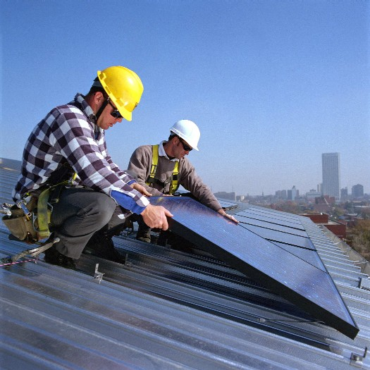
Increased Solar - Impacts
Economic – grid parity achieved
Italian expertise in molten salt thermal plants
Employment
PV Installation
Source: Direct Solar
Notes:
Grid parity occurs when generation costs are roughly equal to electricity prices. It is expected that grid parity will be achieved in most of europe by 2030 (IEA).
A report by Deutsche Bank says that for small commercial enterprises that can achieve >50% self consumption, solar power is competitive with grid electricity in most parts of Italy.
ANEST organisation to develop concentrating solar power. Molten Salt CSP schemes allow 24 hour generation due to heat storage. The Archimede plant in the South is the first power station to solely use molten salt for heat transfer and storage. IEA says CSP has the highest growth potential (28% global demand by 2060 according to IEA). Develop Italian tool chain and technology potentially for export. 50MW plant requires 1500 people to construct for 2-3 years. Source ANEST.
Currently employes around 100,000 people in the PV tool chain.

Slide 20
Increased Solar - Impacts
Economic – grid parity achieved
Italian expertise in molten salt thermal plants
Employment
Land Use/Costs
Notes:
Grid parity occurs when generation costs are roughly equal to electricity prices. It is expected that grid parity will be achieved in most of europe by 2030 (IEA).
A report by Deutsche Bank says that for small commercial enterprises that can achieve >50% self consumption, solar power is competitive with grid electricity in most parts of Italy.
ANEST organisation to develop concentrating solar power. Molten Salt CSP schemes allow 24 hour generation due to heat storage. The Archimede plant in the South is the first power station to solely use molten salt for heat transfer and storage. IEA says CSP has the highest growth potential (28% global demand by 2060 according to IEA). Develop Italian tool chain and technology potentially for export. 50MW plant requires 1500 people to construct for 2-3 years. Source ANEST.

Slide 21
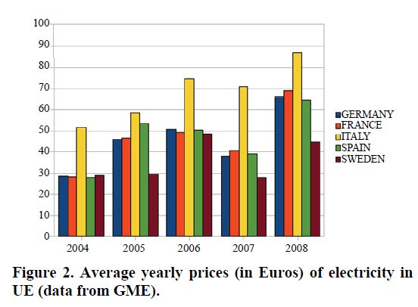
Energy market
Former Monopoly, recently liberalised (privatised), EU directive [1]
Still High prices! Why?
Little coal, no Nuclear
50% foreign gas powered
Privatisation=bad (e.g. Indonesia) [3]
Solutions:
Renationalisation
More renewables
Stumbling blocks:
Bureaucracy/corruption
Renewable High unit price (cents/kWh)
Grid Bottlenecks limit transfer rates
Notes:
[1] http://www.geni.org/globalenergy/library/national_energy_grid/italy/ItalyCountryAnalysisBrief.shtml
[2] www.scirp.org/journal/PaperDownload.aspx?paperID=2695‎
[3] www.psiru.org/reports/9910-e-u-prob.doc

Slide 22
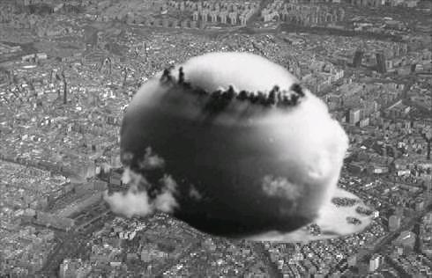
Rejected Options
Nuclear
Public Unacceptance
Fukushima/Chernobyl
Radioactive cloud caused by the Chernobyl explosion in Ukraine [1].
[1]. Postiar.com. 2013. Chernobyl: The Worst Nuclear Disaster In History. [online] Available at: http://www.postiar.com/post/18824/chernobyl-the-worst-nuclear-disaster-in-history.html [Accessed: 17 Oct 2013].
Notes:
4 nuclear reactors
had been shut down in 1987 following the Chernobyl accident.
1990, the last nuclear reactor
turned back to the thermoelectric sector.
In 2008, planned to revive the nuclear program –25% electricity needs.
- rejected by Italian voters in 2011- (Fukushima tragedy)
Italy has had 4 nuclear reactors before,
but, they had been shut down in 1987 following the Chernobyl accident.
In 1990, the last nuclear reactor in Italy was closed.
It’s energy strategy turned back to thermoelectric (fossil fuels) sector.

Slide 23
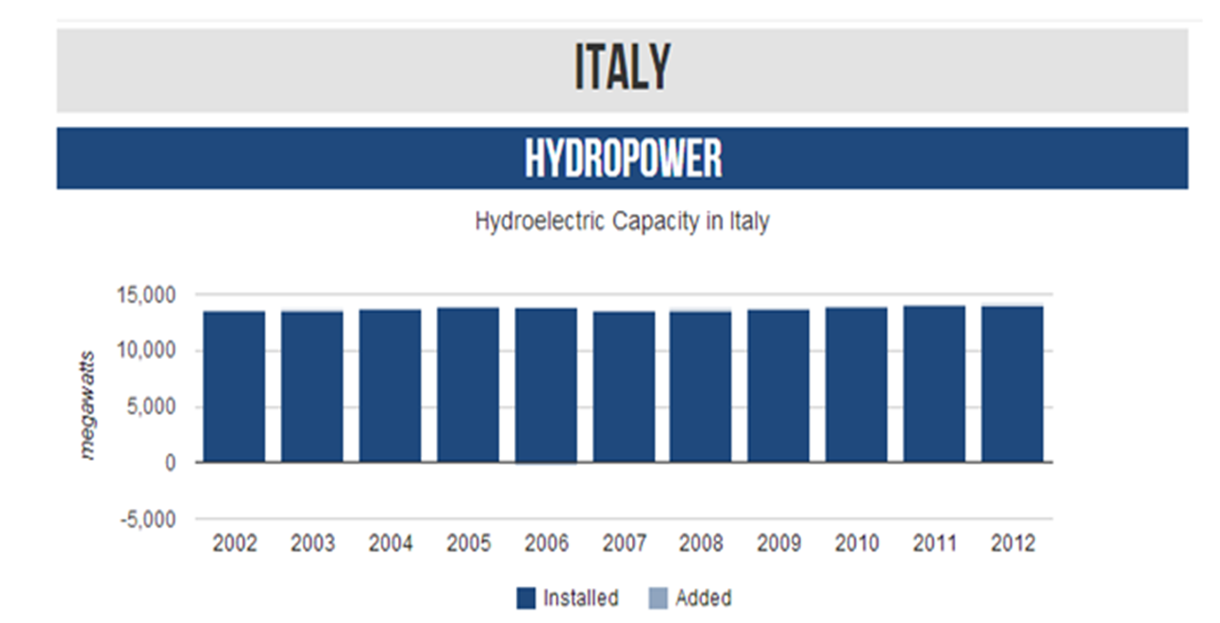
Rejected Options
Nuclear
Public Unacceptance
Fukushima/Chernobyl
Hydro
Largely Exploited
1GW Left
Source: Facts, R. 2013. Hydropower. [online] Available at: http://www.renewablefacts.com/country/italy/hydro [Accessed: 20 Oct 2013].
Notes:
Large scale hydro projects - almost fully exploited
- very few suitable sites
-hostility of local populations
-Impact on tourism
Mini Hydro?
-In 2010, overall installed capacity =2.655GW
-potential for further development = 1GW
(Large Scale Hydro)
Total installed capacity in 2002 = 13456MW ( or 13.4GW)
Total installed capacity in 2012 = 14196MW (or 14.2GW)
Changes in 10 years = 740MW
In 2010, small and mini hydro plants achieved an overall installed capacity of 2.655GW

Slide 24
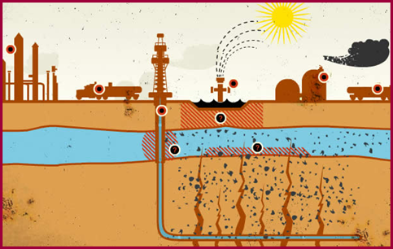
Rejected Options
Nuclear
Public Unacceptance
Fukushima/Chernobyl
Hydro
Largely Exploited
1GW Left
Fracking
Public Unacceptance
Source: Journal, R. 2013. Fracking. [online] Available at: http://burnanenergyjournal.com/rome-burns-when-the-earth-shook-was-fracking-to-blame/ [Accessed: 18 Oct 2013].
Notes:
Fracking contaminates the surrounding crops and water.
Has been hugely suggested as the cause of earthquakes. (Emilia Romagna – which has natural gas reserves) .

Slide 25
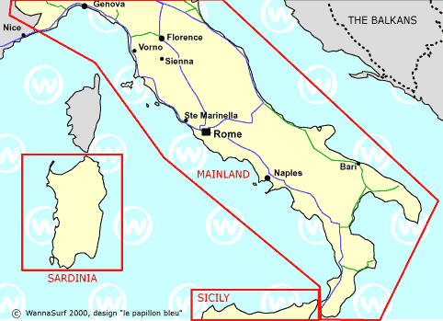
Rejected Options
Nuclear
Public Unacceptance
Fukushima/Chernobyl
Hydro
Largely Exploited
1GW Left
Fracking
Public Unacceptance
Wave
Inefficient
Notes:
http://www.wannasurf.com/spot/Europe/Italy/
Inefficient and cost/benefit to the tourism that it brings in reinforces this.

Slide 26
Summary

Slide 27
Thank you for listening

